Slide 1

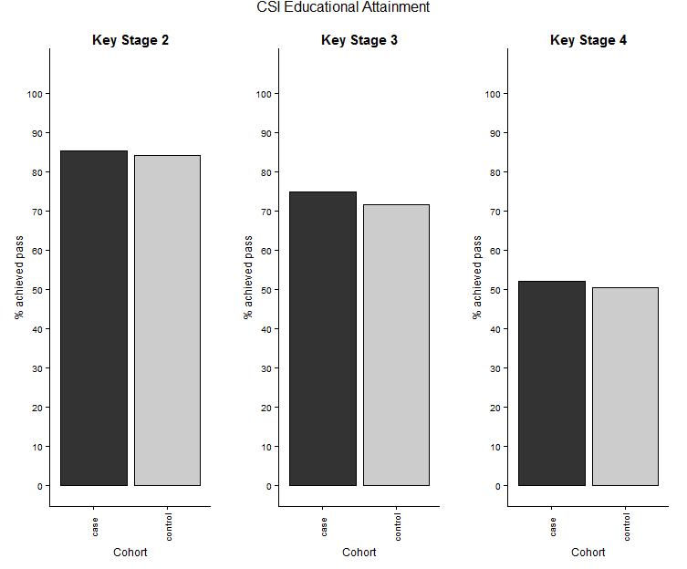
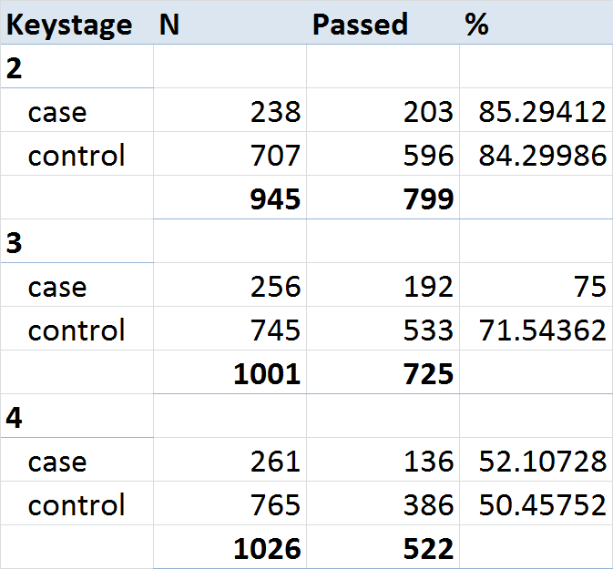
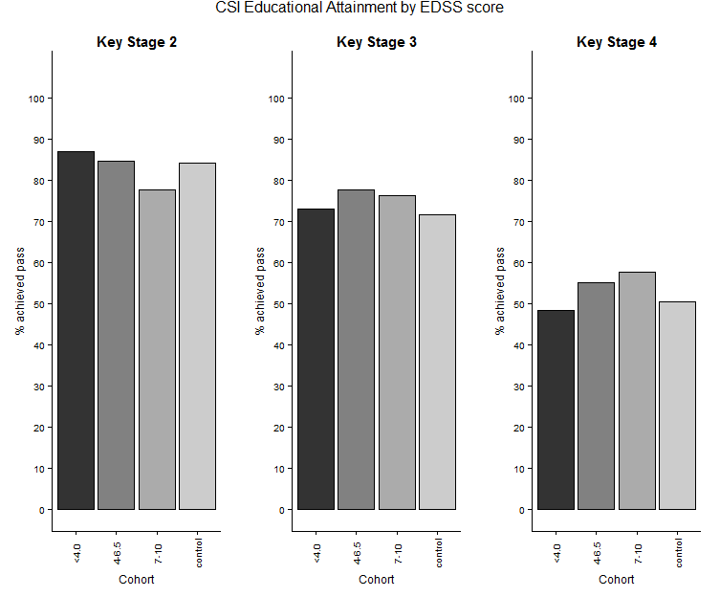
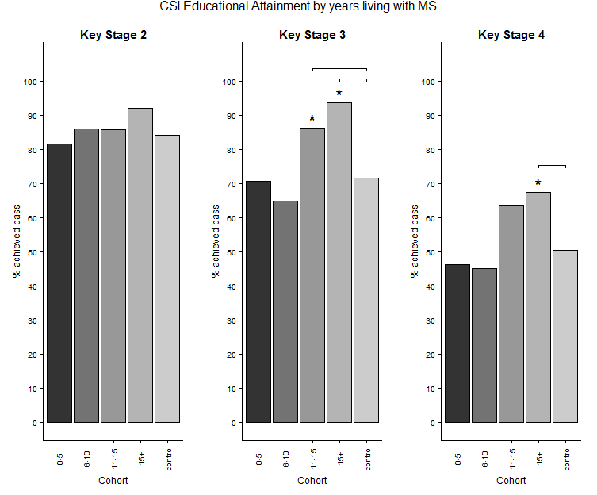




Educational Attainment of Children born to Mothers with MS Lacey AS^{1,2}*, Pickrell WO^{1,3}*, Harding K^{4,5}, Middleton R², Tallantyre EC⁵⁶, Ingram G³, Pearson OR³, Rees MI¹, Robertson NP^{5,6}.
*=equal contribution. 1 - Neurology and Molecular Neuroscience, Swansea University Medical School, Swansea University 2 - Data Science Building, Health Data Research UK, Swansea University Medical School, Swansea University 3 - Neurology Department, Morriston Hospital, Swansea Bay University Health Board, Swansea 4 - Neurology Department, Royal Gwent Hospital, Aneurin Bevan University Health Board, Newport 5 - Institute of Psychological Medicine and Clinical Neurosciences, Cardiff University School of Medicine, Cardiff 6 - Neurology Department, University Hospital of Wales, Cardiff and Vale University Health Board, Cardiff
contact : w.o.pickrell@swansea.ac.uk
Background
Results
Multiple sclerosis (MS) causes long-term disability with broad socioeconomic consequences. This may influence educational attainment in children of affected individuals. We investigated whether having a mother with MS affects performance in Welsh national attainment tests
Method
We linked anonymised lists of 1584 women with MS diagnosed in two neuroscience centres (Cardiff, Swansea) to population level routinely-collected health and education data in the Secure Anonymised Information Linkage (SAIL) Databank. We identified children born to mothers with MS and compared performance in Key Stage (KS) 2–4 tests, taken at ages 11, 14 and 16, to a control group (matched for deprivation score, maternal age, year of birth, gestational age and birth weight). We measured core subject indicator (CSI) as an outcome measure (proportion achieving minimum standard in core subjects).
Put in numbers of children here etc.
MS diagnoses Cardiff
Datasets that we used
Controls
MS diagnoses Swansea
Conclusions
Having a mother with MS did not significantly worsen performance in national attainment tests and was associated with improved performance in some subgroups.
Another point here about subgroup analysis, comparison with Danish study
Possible reasons and relevance
Acknowledgements
This study makes use of anonymised data held in the Secure Anonymised Information Linkage (SAIL) system. We would like to acknowledge all the data providers who make anonymised data available for research. We are grateful to the ABN for providing a bursary for this poster. We acknowledge the support from the Farr Institute @ CIPHER. We also acknowledge support from the Brain Repair and Intracranial Neurotherapeutics (BRAIN) Unit which is funded by Health and Care Research Wales. The work has also been supported by the Academy of Medical Sciences (Starter grant for medical sciences, WOP).

